Slide 1
Application of array
Sorting and Searching

Slide 2
Contents
What is sorting
-- Bubble Sort
What is searching
-- Linear Search
-- Binary Search

Slide 3
Application Of Array :
Stores Elements of Same Data Type
Array is used to store the number of elements that are of same data type.
Eg: int students[30];
array of marks of five subjects for single student.
float marks[5];
array of marks of five subjects for 30 students.
float marks[30][5]
Similarly if we declare the character array then it can hold only character.
So in short character array can store character variables while floating array stores only floating numbers.

Slide 4
Array Used for Maintaining multiple variable names using single name
Suppose we need to store 5 roll numbers of students then without declaration of array we need to declare following -
int roll1,roll2,roll3,roll4,roll5;
Now in order to get roll number of first student we need to access roll1.
Guess if we need to store roll numbers of 100 students then what will be the procedure.
Maintaining all the variables and remembering all these things is very difficult.
So we are using array which can store multiple values and we have to remember just single variable name.

Slide 5
Sorting
A Sorting Algorithm is used to rearrange a given array or list elements according to a comparison operator on the elements. The comparison operator is used to decide the new order of element in the respective data structure.
For example: The below list of characters is sorted in increasing order of their ASCII values. That is, the character with lesser ASCII value will be placed first than the character with higher ASCII value.
zdcba WILL BE rearranged as abcdz

Slide 6
Array Can be Used for Sorting Elements
We can store elements to be sorted in an array and then by using different sorting technique we can sort the elements.
Different Sorting Techniques are :
1. Bubble Sort
2. Insertion Sort
3. Selection Sort
Notes:
To sort the elements without using array we have to compare each and every variable individually without using loops.

Slide 7
Sorting
Sorting data
Important computing application
Virtually every organization must sort some data

Slide 8
Bubble sort
Bubble sort (sinking sort)
A simple but inefficient sorting technique.
Several passes through the array
Successive pairs of elements are compared
If increasing order (or identical ), no change
If decreasing order, elements exchanged
Repeat

Slide 9
Bubble sort
Comparing successive elements
77 | 56 | 4 | 10 | 34 | 2
56 | 4 | 10 | 34 | 2 | 77
4 | 10 | 34 | 2 | 56 | 77
4 | 10 | 2 | 34 | 56 | 77
4 | 2 | 10 | 34 | 56 | 77
2 | 4 | 10 | 34 | 56 | 77
Original array
After pass 1
After pass 2
After pass 3
After pass 4
After pass 5
Total number of pass required for sorting: n-1

Slide 10
Bubble sort
It’s called bubble sort or sinking sort because smaller values gradually “bubble” their way to the top of the array (i.e., toward the first element) like air bubbles rising in water, while the larger values sink to the bottom (end) of the array.
The technique uses nested loops to make several passes through the array.
Each pass compares successive pairs of elements.
If a pair is in increasing order (or the values are equal), the bubble sort leaves the values as they are.
If a pair is in decreasing order, the bubble sort swaps their values in the array.

Slide 11
Bubble sort
The first pass compares the first two elements of the array and swaps their values if necessary. It then compares the second and third elements in the array. The end of this pass compares the last two elements in the array and swaps them if necessary.
After one pass, the largest element will be in the last index. After two passes, the largest two elements will be in the last two indices.

Slide 12
Program example-WAP to sort elements of 1D array in ascending order using Bubble sort
#include <stdio.h>
int main()
{
int a[100];
int hold,i,j,n;
printf("\n Enter value of n:");
scanf("%d",&n);
printf("\n Enter elements:");
for(i=0;i<n;i++)
{
scanf("%d",&a[i]);
}
printf( "Data items in original order" );
for (i=0;i<n;i++ )
{
printf("%d ",a[i]);//Elements will come with space
} // end for
// bubble sort
// loop to control number of passes(no. of passes are always n-1)
for (i=0;i<n-1;i++)
{
// loop to control number of comparisons per pass(There is one comparison less)
for (j=0;j<n-i-1;j++)
{
// compare adjacent elements and swap them if first
// element is greater than second element
if (a[j]>a[j+1])
{
hold=a[j];
a[j]=a[j+1];
a[j+1]=hold;
} // end if
} // end inner for
} // end outer for
printf( "\nData items in ascending order" );
for (i=0;i<n;i++)
{
printf("%d ",a[i]);
} // end for
} // end main

Slide 13
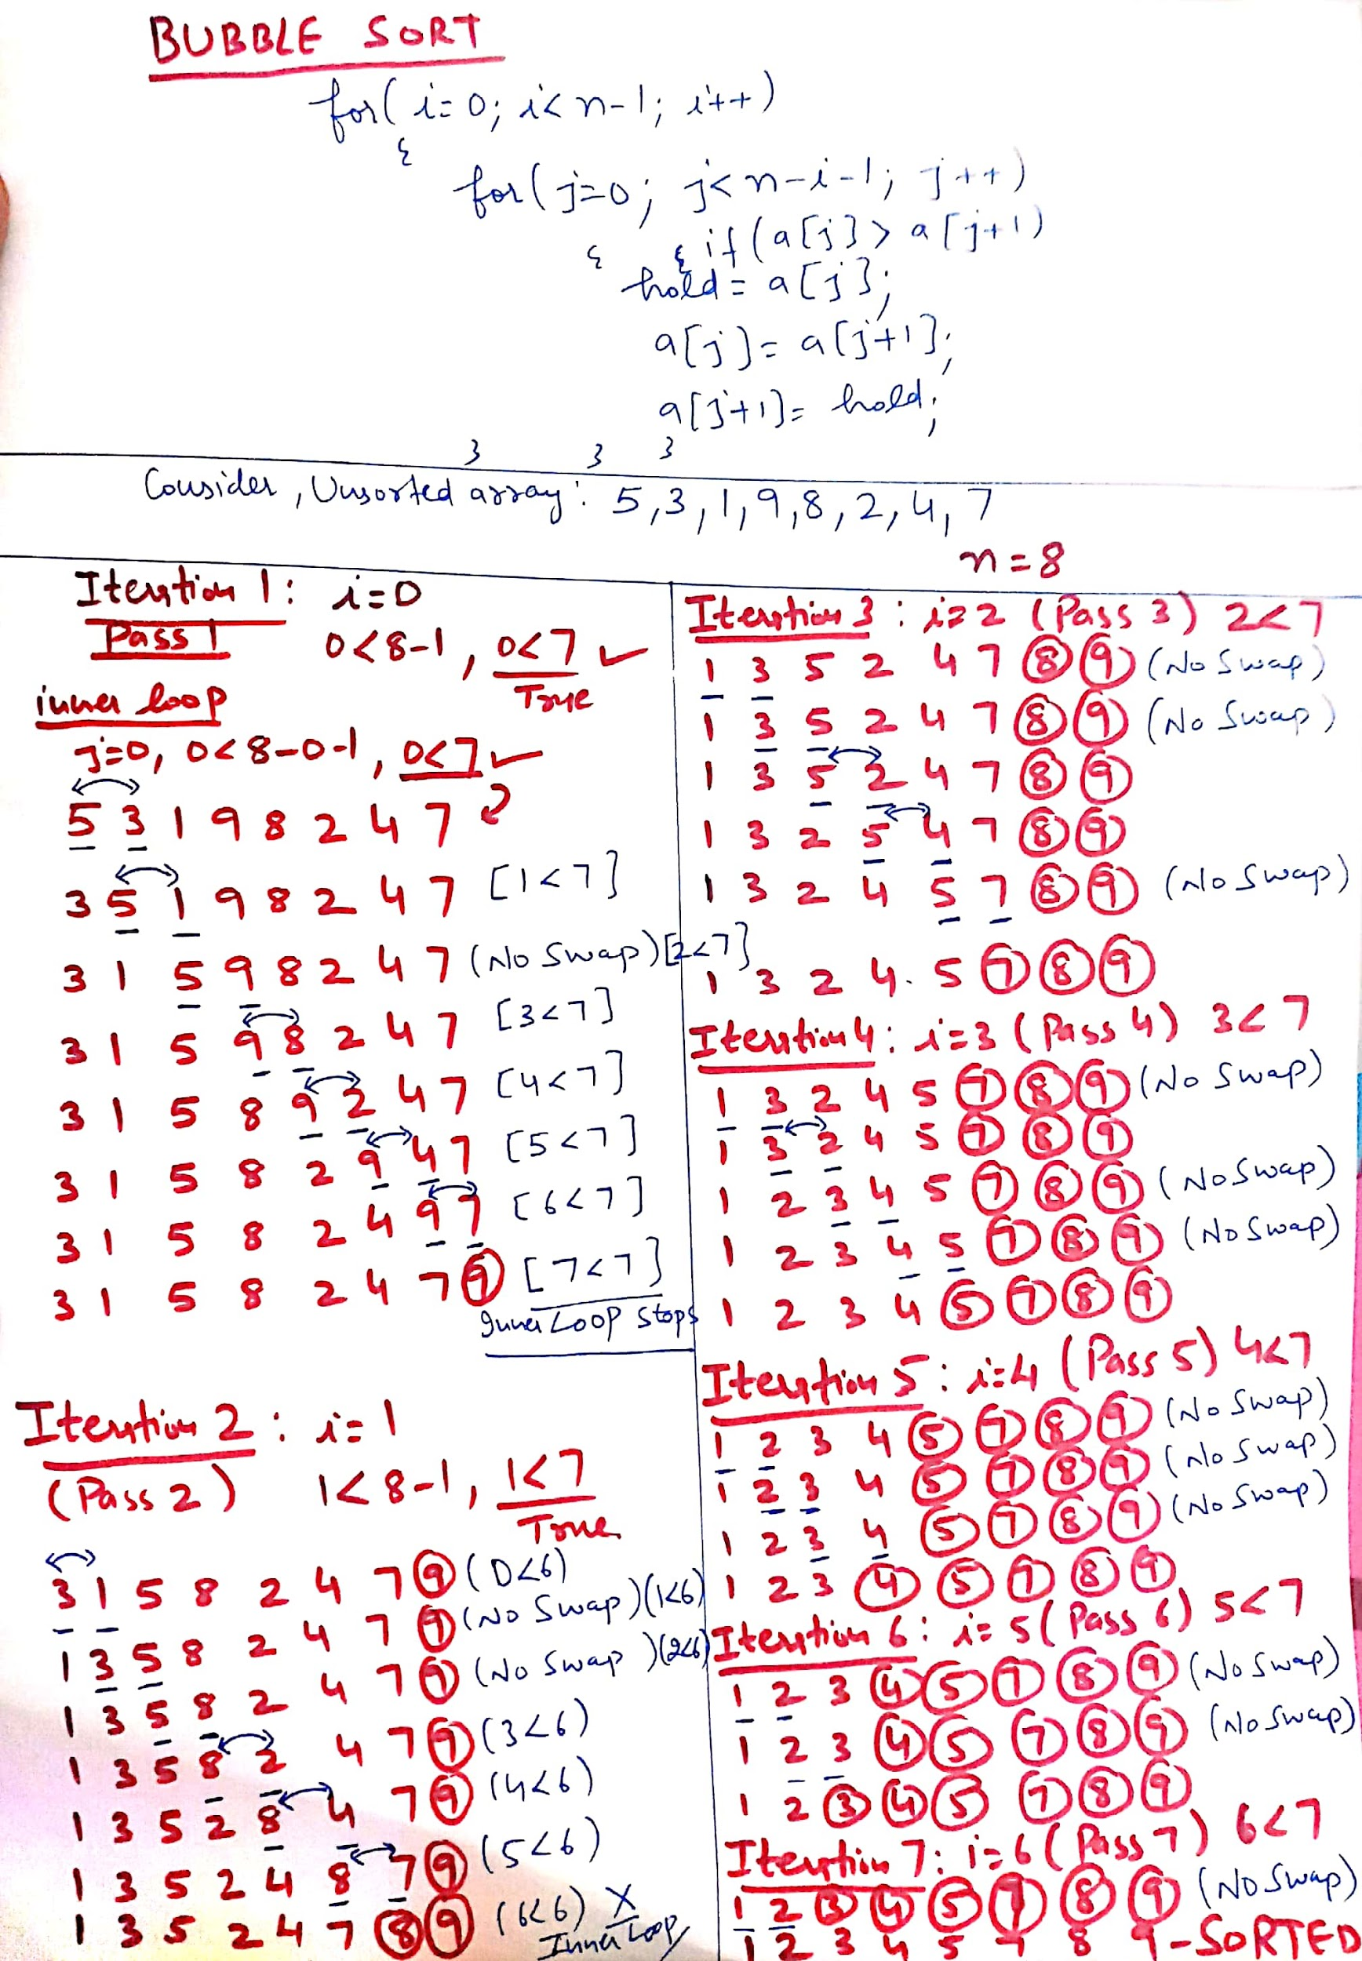
Dry running

Slide 14
Assume that we use Bubble Sort to sort n distinct elements in ascending order. When does the best case of Bubble Sort occur?
A. When elements are sorted in ascending order
B. When elements are sorted in descending order
C. When elements are not sorted by any order
D. There is no best case for Bubble Sort. It always takes O(n*n) time

Slide 15
Assume that we use Bubble Sort to sort n distinct elements in ascending order. When does the best case of Bubble Sort occur?
A. When elements are sorted in ascending order
B. When elements are sorted in descending order
C. When elements are not sorted by any order
D. There is no best case for Bubble Sort. It always takes O(n*n) time

Slide 16
The number of swappings needed to sort the numbers 8, 22, 7, 9, 31, 5, 13 in ascending order, using bubble sort is
A. 11
B. 12
C. 13
D. 10

Slide 17
The number of swappings needed to sort the numbers 8, 22, 7, 9, 31, 5, 13 in ascending order, using bubble sort is
A. 11
B. 12
C. 13
D. 10

Slide 18
Explanation: 1 : 8, 7, 9, 22, 5, 13, 31 = 4 swaps
2 : 7, 8, 9, 5, 13, 22, 31 = 3 swaps
3 : 7, 8, 5, 9, 13, 22, 31 = 1 swap
4 : 7, 5, 8, 9, 13, 22, 31 = 1 swap
5 : 5, 7, 8, 9, 13, 22, 31 = 1 swap
Total 10 swaps are required to sort the array.

Slide 19
Searching in Arrays
The process of finding a particular element of an array is called searching.
Search an array for a key value.
Two searching techniques:
Linear search
Binary search

Slide 20
Linear Search
A linear search, also known as a sequential search, is a method of finding an element within a list. It checks each element of the list sequentially until a match is found or the whole list has been searched.
A simple approach to implement a linear search is
Begin with the leftmost element of arr[] and one by one compare x with each element.
If x matches with an element then return the index.
If x does not match with any of the elements then return -1.

Slide 21
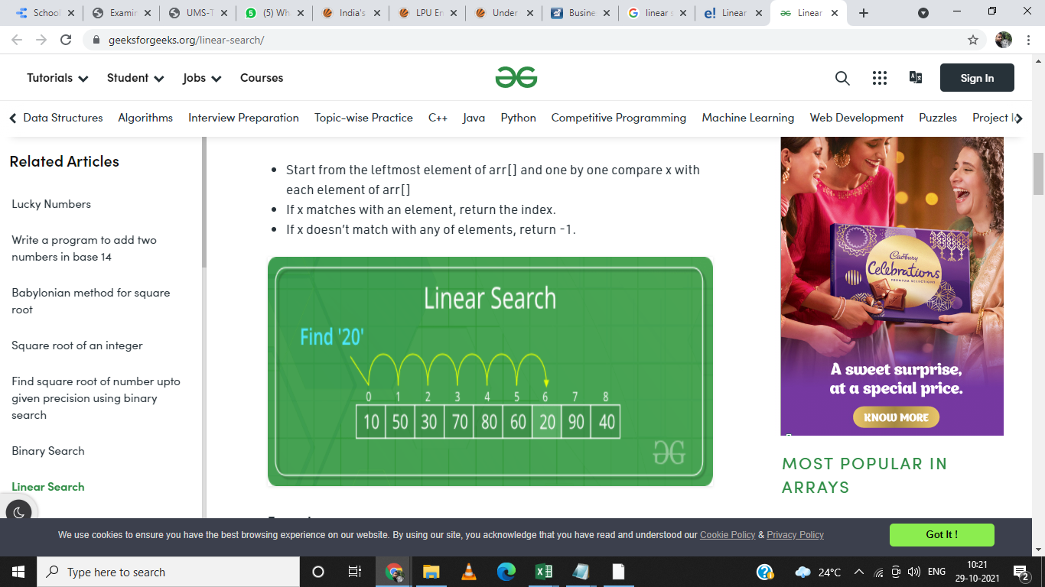
Linear Search

Slide 22
Linear search
Linear search
Simple
Compare each element of array with key value
Useful for small and unsorted arrays
It simply examines each element sequentially, starting with the first element, until it finds the key element or it reaches the end of the array.
Example: If you were looking for someone on a moving passenger train, you would use a sequential search.

Slide 23
Program example-WAP to implement linear search in 1D array element
#include <stdio.h>
int main()
{
int a[50];
int i, loc = -1, key,n;
printf("\n Enter value of n:");
scanf("%d",&n);
printf("\n Enter the elements:");
for(i=0;i<n;i++)
{
scanf("%d",&a[i]);
}
printf("Enter integer value to search in array:");
scanf( "%d", &key );
// attempt to locate searchKey in array a
for ( i = 0; i < n; i++ )
{
if ( a[i] == key )
{
loc = i; // location of key is stored
break;
} // end if
} // end for
if(loc!= -1)
{
printf("Element found at %d",loc+1);
}
else
{
printf("Element not found");
}
} // end main

Slide 24
The time required to search an element using a linear search algorithm depends on the size of the list.
In the best-case scenario, the element is present at the beginning of the list and in the worst-case, it is present at the end.

Slide 25
The array is as follows: 1,2,3,6,8,10. At what time the element 6 is found? (By using linear search(recursive) algorithm) a) 4th call b) 3rd call c) 6th call d) 5th call

Slide 26
The array is as follows: 1,2,3,6,8,10. At what time the element 6 is found? (By using linear search algorithm) a) 4th call b) 3rd call c) 6th call d) 5th call

Slide 27
Binary Search
A Binary Search is a sorting algorithm, that is used to search an element in a sorted array.
A binary search technique works only on a sorted array, so an array must be sorted to apply binary search on the array.
It is a searching technique that is better then the liner search technique as the number of iterations decreases in the binary search.

Slide 28
Binary search
Binary search
Applicable for sorted arrays
The algorithm locates the middle element of the array and compares it to the key value.
Compares middle element with the key
If equal, match found
If key < middle, looks in left half of middle
If key > middle, looks in right half of middle
Repeat (the algorithm is repeated on one-quarter of the original array.)

Slide 29
Binary search
It repeatedly divides the sequence in two, each time restricting the search to the half that would contain the element.
This is a tremendous increase in performance over the linear search that required comparing the search key to an average of half of the array elements.
You might use the binary search to look up a word in a dictionary

Slide 30
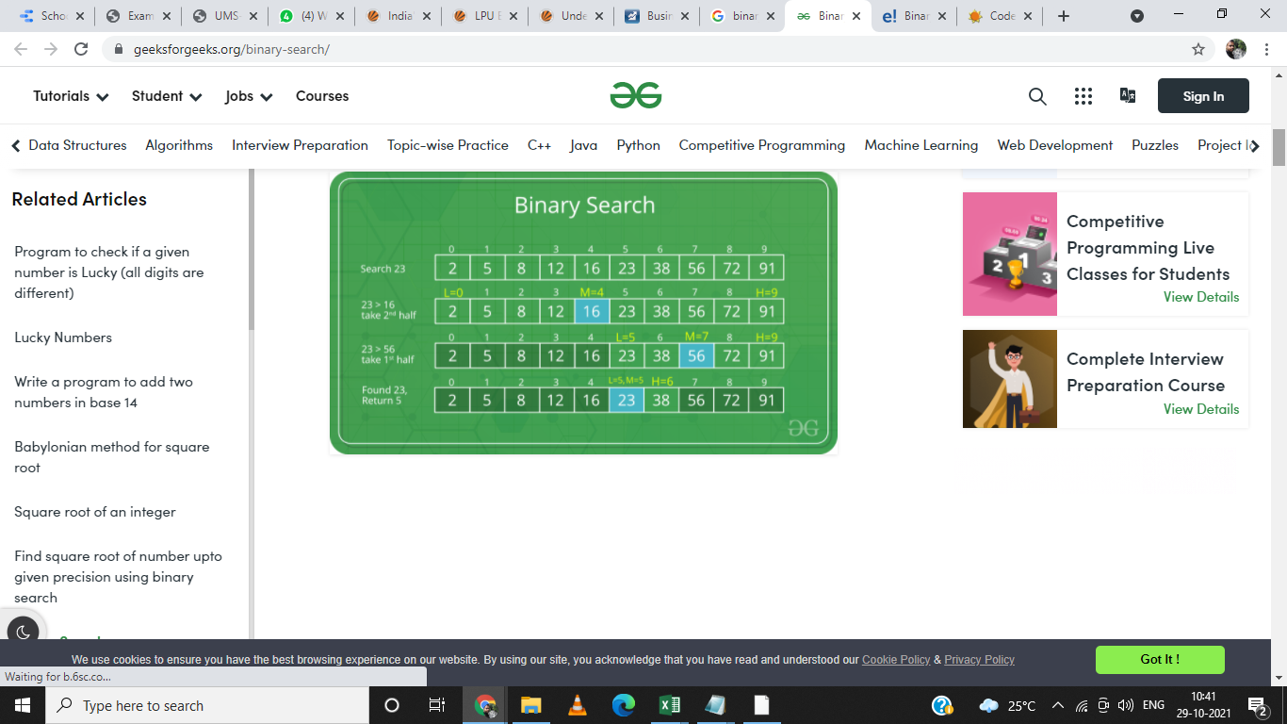

Slide 31
Program example-WAP to implement Binary Search in 1D array elements
#include<stdio.h>
int main()
{
int a[50],n,loc=-1, key, beg,last,mid,i;
printf("\n Enter number of array elements:");
scanf("%d",&n);
printf("\n Enter array elements:");
for(i=0;i<n;i++)
{
scanf("%d",&a[i]);
}
beg=0;
last=n-1;
printf("Enter integer value to search in sorted array:");
scanf( "%d", &key );
while(beg<=last)//Loop will run until unless only one element is not remaining
{
mid = (beg + last) / 2; // determine index of middle element
if(a[mid]==key)
{
loc=mid; //save the location of element.
break;
}
else if(a[mid]>key) //Middle element is greater than key
{
last=mid-1;//If middle element is greater than key, we need to search left subarray
}
else if(a[mid]<key) //Middle element is less than key
{
beg=mid+1;//If middle element is less than key, we need to search right subarray
} //end of if else
} //end of while
if(loc!=-1)
{
printf("element found at %d", loc+1);//Location is exact position, not index
}
else
{
printf("element not found");
}
return 0;
}

Slide 32
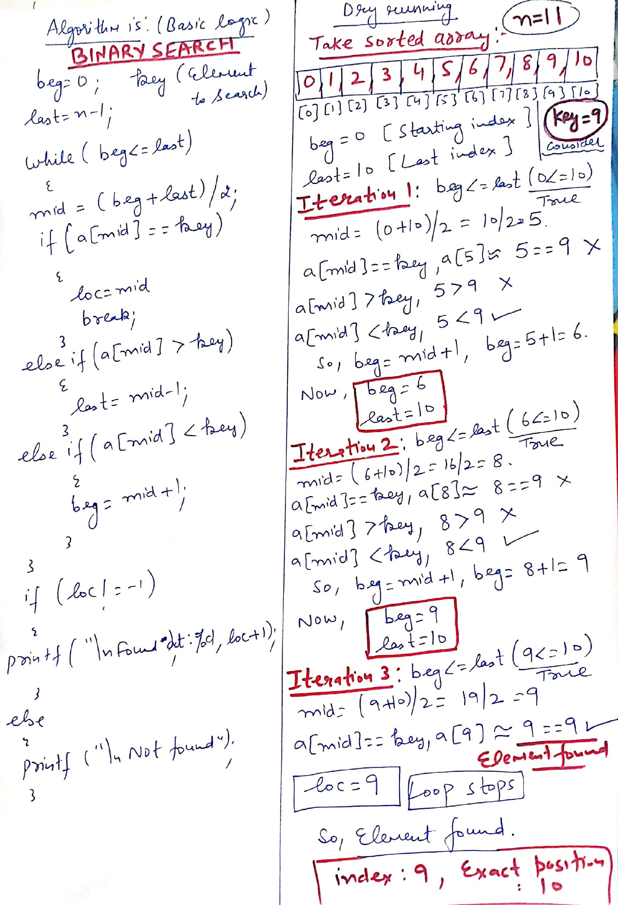
Dry running

Slide 33
Given an input arr = {2,5,7,99,899}; key = 899; What is the level of recursion? a) 5 b) 2 c) 3 d) 4

Slide 34
Given an input arr = {2,5,7,99,899}; key = 899; What is the level of recursion? a) 5 b) 2 c) 3 d) 4
Explanation: level 1: mid = 7 level 2: mid = 99 level 3: mid = 899(this is the key).

Slide 35
Given an array arr = {45,77,89,90,94,99,100} and key = 99; what are the mid values(corresponding array elements) in the first and second levels of recursion? a) 90 and 99 b) 90 and 94 c) 89 and 99 d) 89 and 94

Slide 36
Given an array arr = {45,77,89,90,94,99,100} and key = 99; what are the mid values(corresponding array elements) in the first and second levels of recursion? a) 90 and 99 b) 90 and 94 c) 89 and 99 d) 89 and 94
Explanation: At first level key = 90 At second level key= 99 Here 90 and 99 are mid values.

